Slide 1
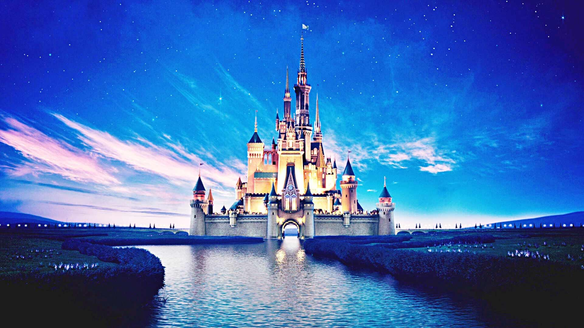

Slide 2
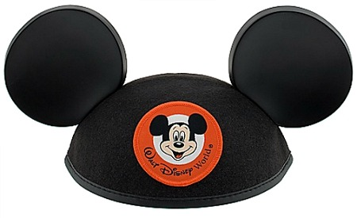
Maynard HS Music Dept
Disney Performance Tour
2023

Slide 3
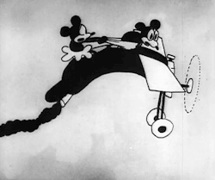
Do’s and Don’ts
Your Flight and the TSA
Personal I.D.
Conduct and Language
Electronic Devices
Flight Attendant Instructions
Carry On’s
Gum
Take what you will need for Day One
Personal-sized (3 oz.) Sunscreen, etc.
Dry Clothing, Hair Ties, Ball Caps

Slide 4
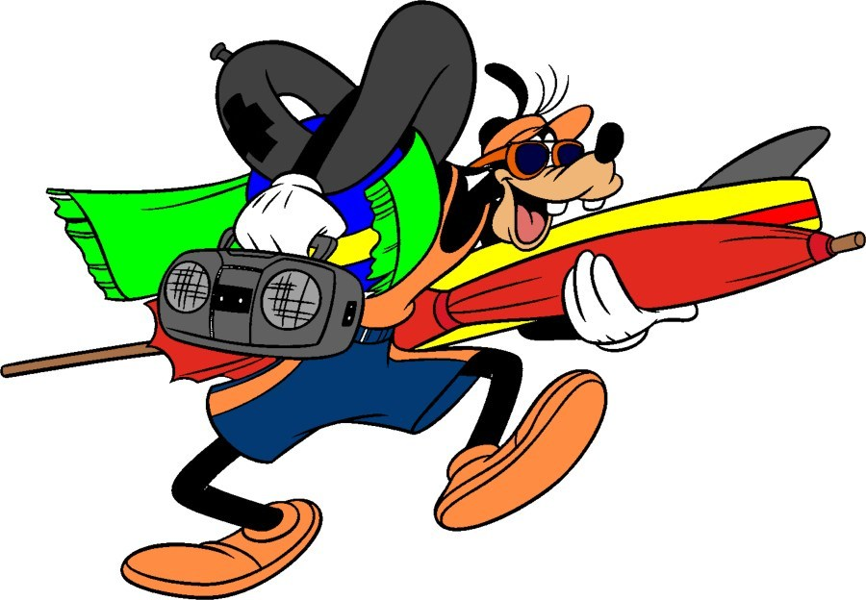
What to Pack
Phone power bank
Extra T-shirt
Poncho
Lip Balm
Kleenex
Autograph Book and Sharpie
“Crystal Light” (singles)
Wet Wipes

Slide 5
Think ahead, Think smart…
Spending Money
Consider “Gift Cards”
Pre-charged Debit Cards
AVOID CASH when at all possible
“Menus” at AllEars.net
Stay Hydrated
Pack simple snacks
Consider a Resort Mug
Hiya Pals!
Let’s get started…

Slide 6
Day One – Arrival Day
Departures and Arrivals
Southwest 766 at 5:05 am
Arrives at 8:00 am
Private Transfer to Animal Kingdom
$35 Disney Dining Card for Dinner
Disney Transfer to All Star Music
Check In

Slide 7
Day Two – Performance Day
Disney Dining card $35 for day
Private Transfers to Disney Springs
Band Performance at 11:45
Chorus Performance at 2:30
Private Transfers to Magic Kingdom
Happily Ever After Fireworks show
Disney Transfer to Resort

Slide 8
Day Three – Workshops
$35 Disney Dining card
Disney Transfer to Epcot
Band Workshop at 6 pm
Choral Workshop at 9:15 pm
Private Transfers to Resort

Slide 9
Day Four – Disney Play Day
$35 Disney Dining card
Disney Transfer to Hollywood Studios
Evening Show: Fantasmic!
Disney Transfer to Resort

Slide 10
Day Five – Departure Day
$25 Disney Dining card
Resort Check-out and Load
Disney Transfer to Magic Kingdom
Private Transfer to Orlando Airport
Departures and Arrivals
Southwest Fl 699 at 9:20 pm
Arrives at 12:05 am

Slide 11
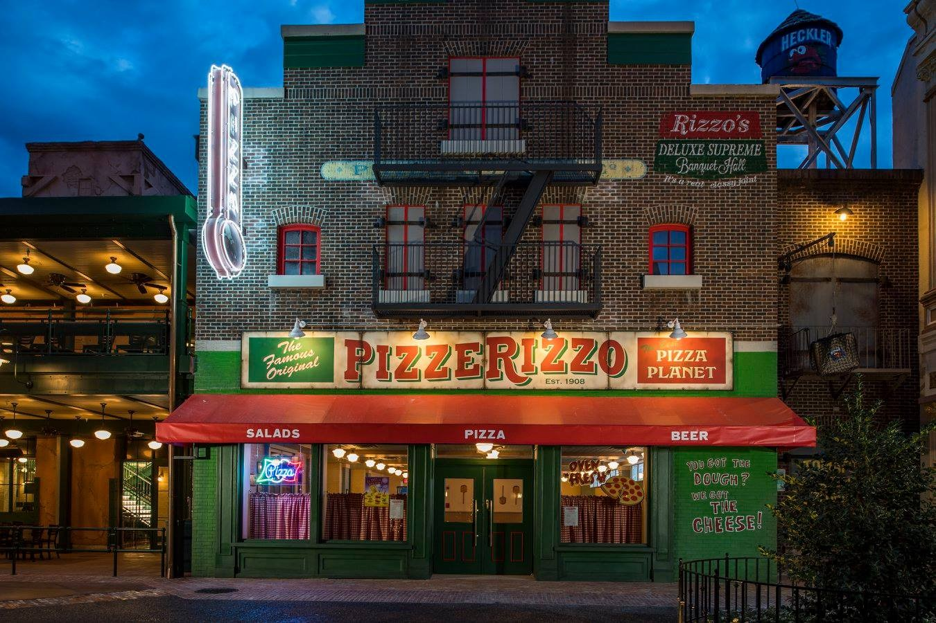
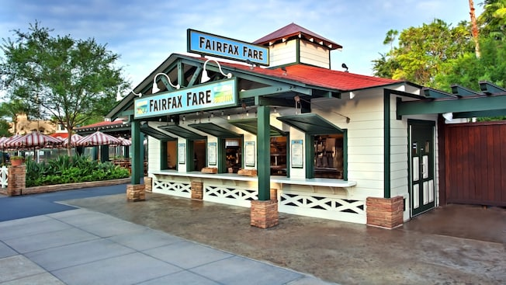
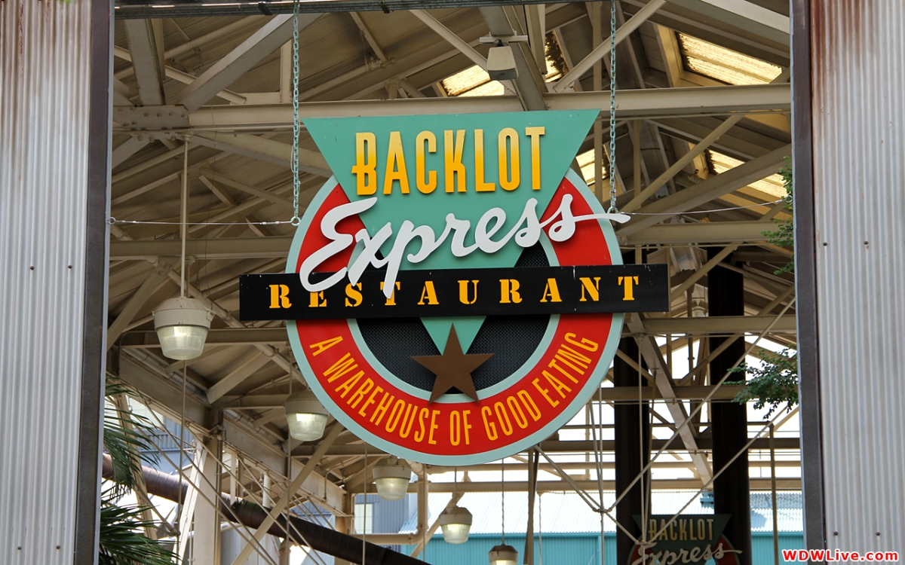
Dining “Best Bets” at Hollywood Studios
PizzeRizzo
Backlot Express
Fairfax Fare

Slide 12
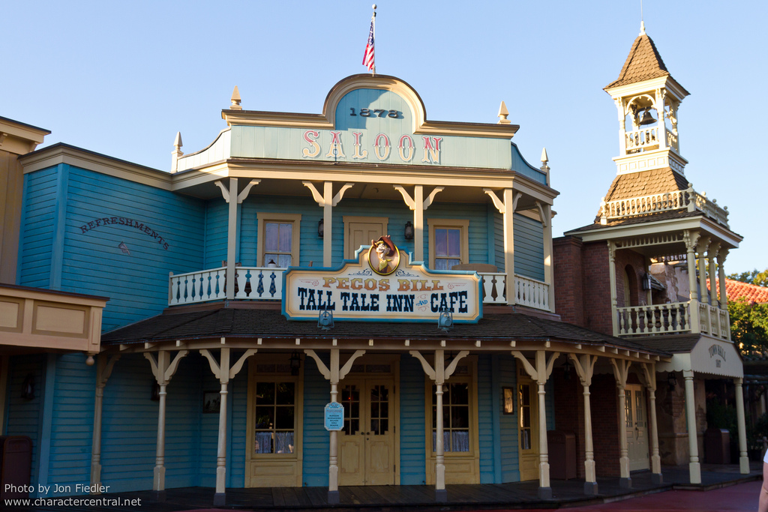
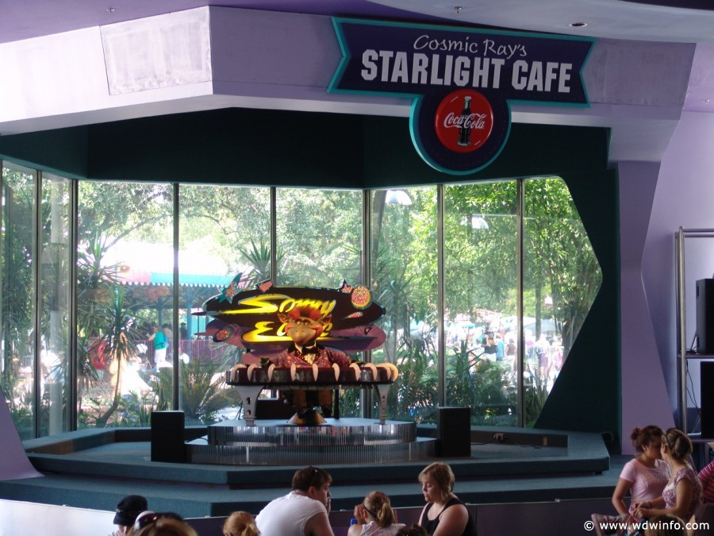
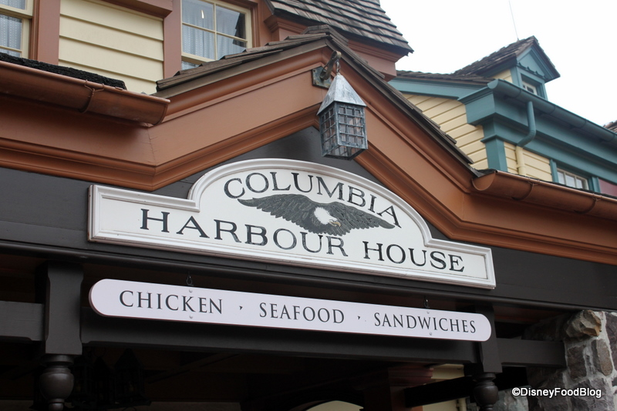
Dining “Best Bets” at Magic Kingdom
Columbia Harbour House
Pecos Bill’s
Cosmic Ray’s

Slide 13
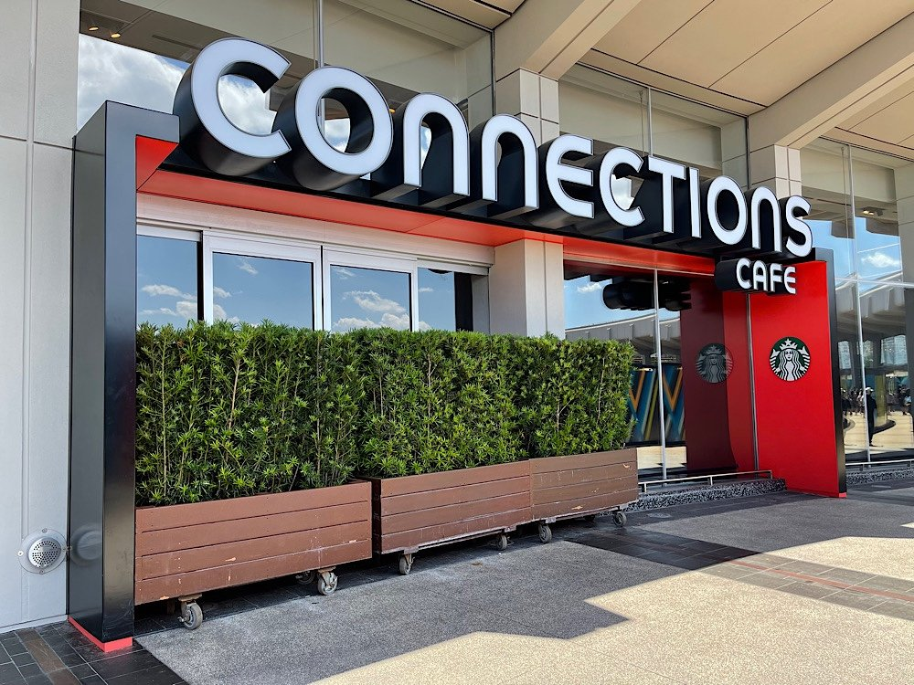
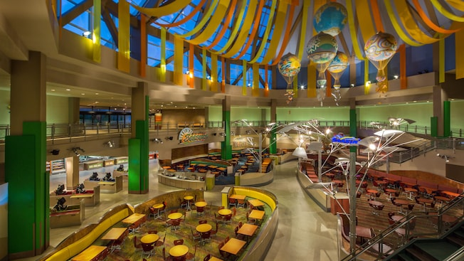
Dining “Best Bets” at Epcot
Future World locations
Connections Cafe

Slide 14
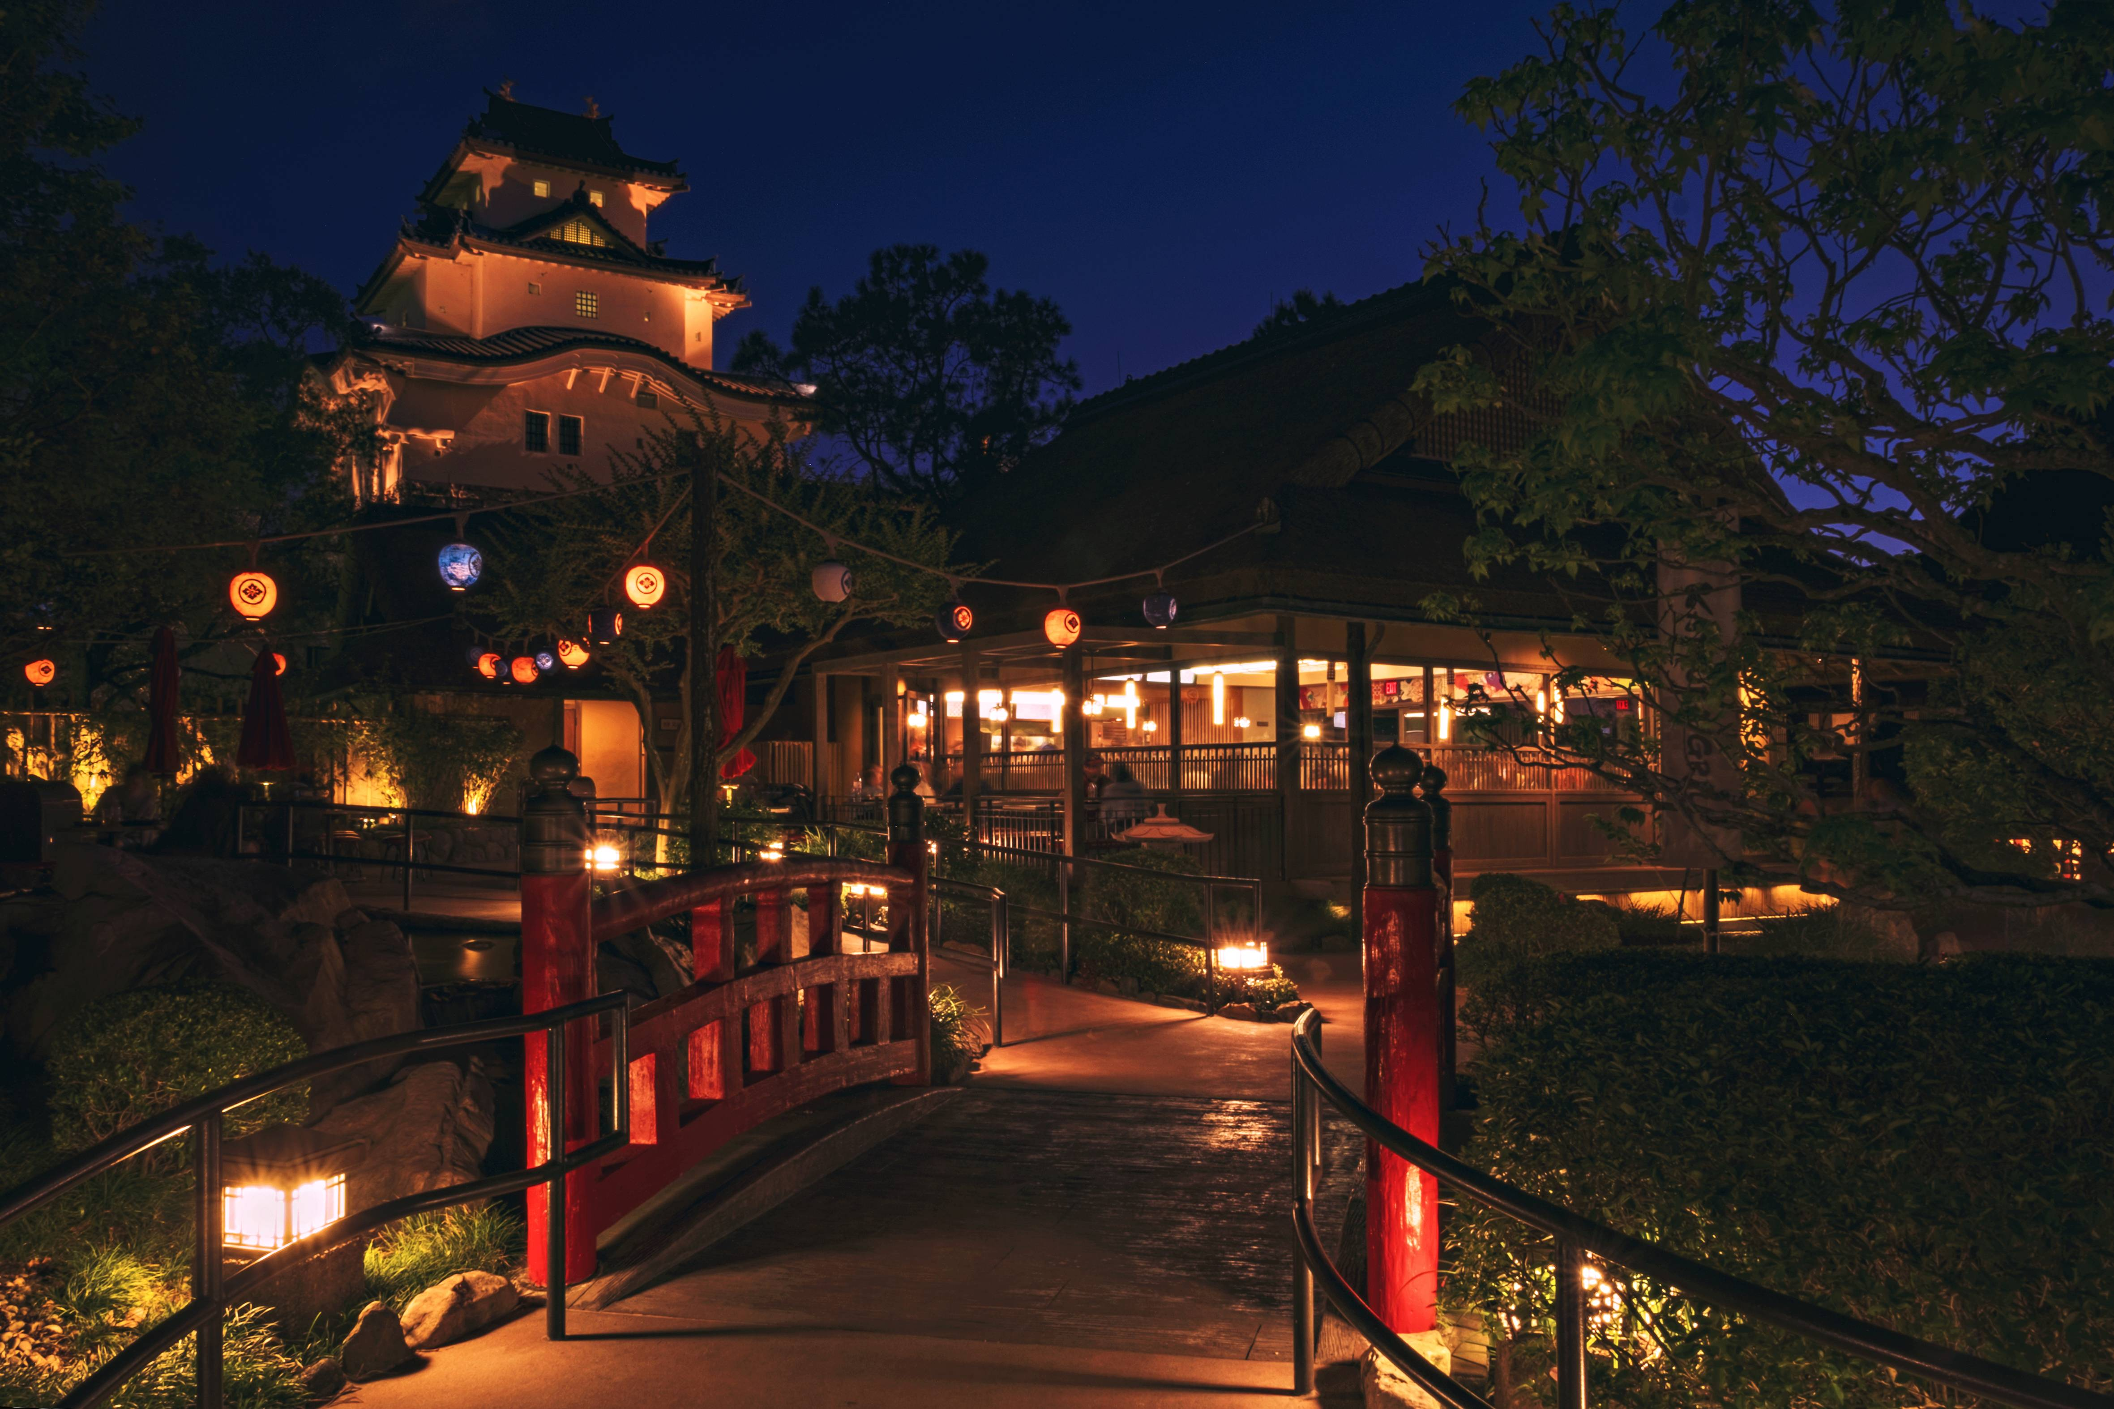
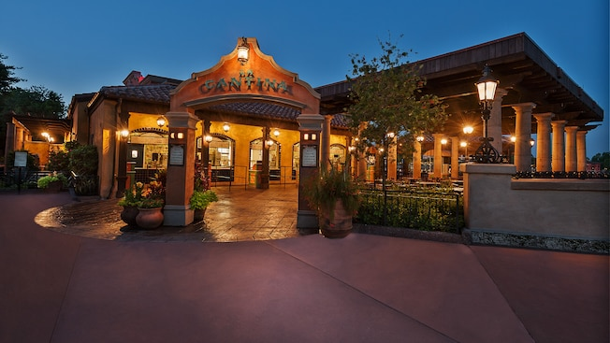
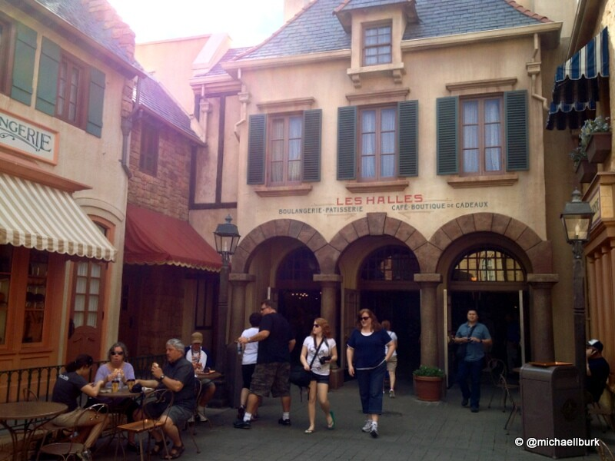
Dining “Best Bets” at Epcot
World Showcase locations
France
Japan
Mexico

Slide 15
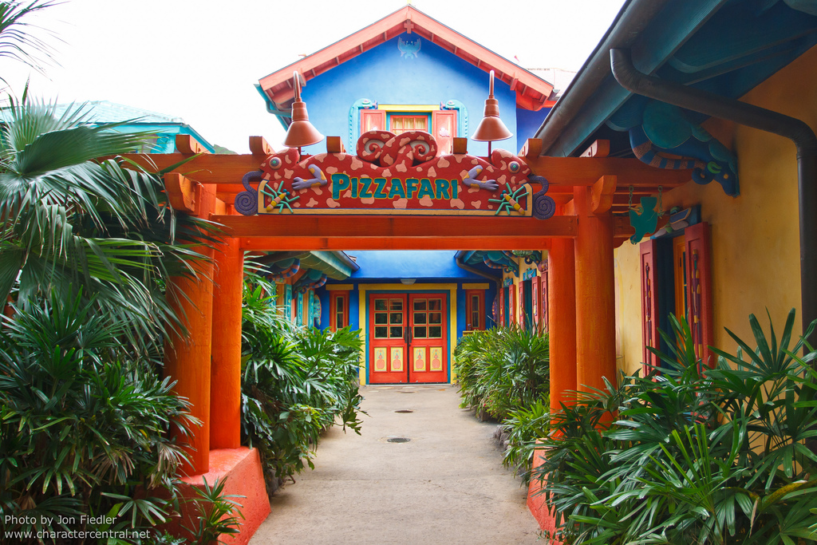
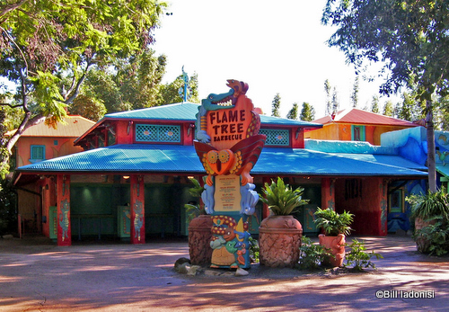
Dining “Best Bets” at Animal Kingdom
Flame Tree BBQ
Pizzafari

Slide 16
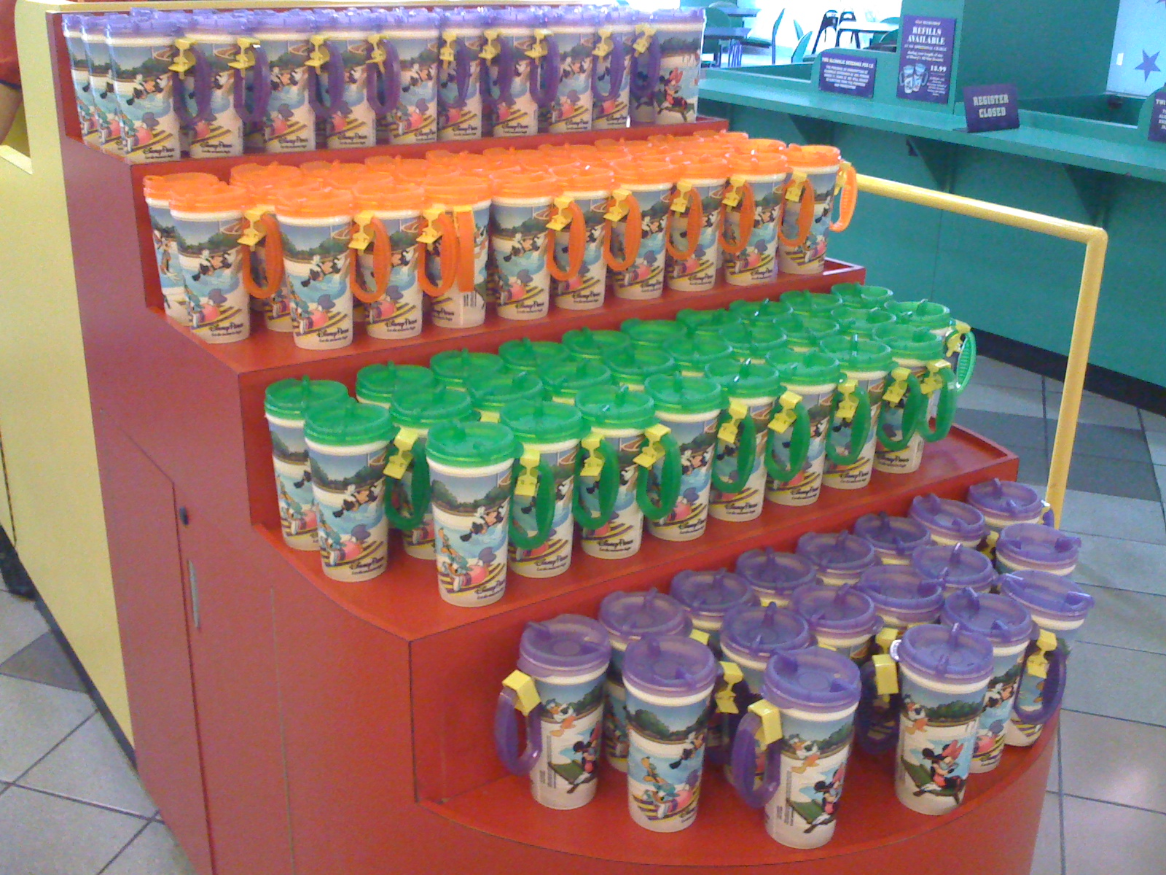
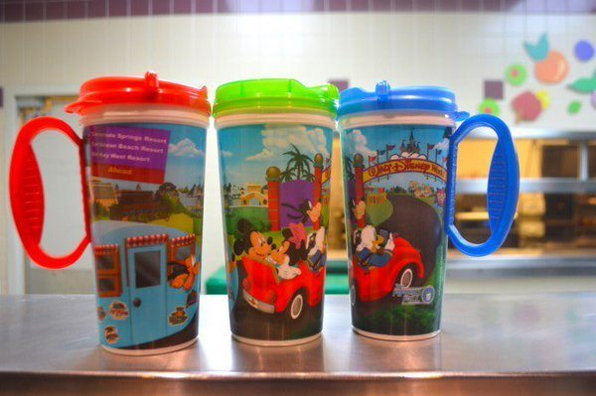
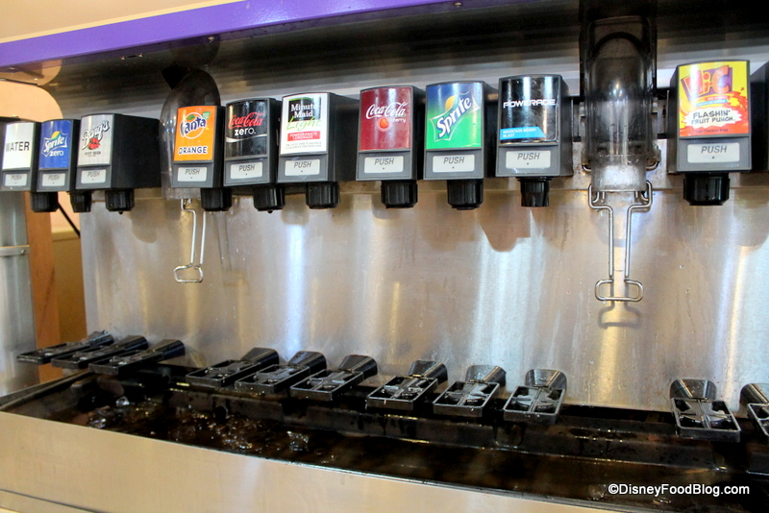
Best Disney Souvenir
$21.99

Slide 17
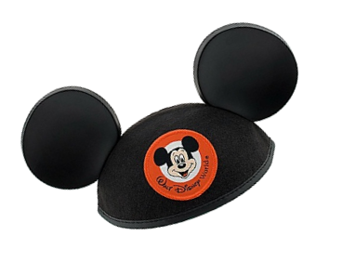
Let’s get your Mickey on..!

