Slide 1
MHS BAND/CHORUS DISNEY 2023
Mandatory Music Family Meeting – March 23, 2023
Photos: Disney 2017

Slide 2
Disney Trip 2023 Planning Committee
Cheryl Lucas, Danny Lucas: Trip Committee Co-Chairs
Kerry Healy: Secretary
Stacey Briggs: Treasurer
Denise Donovan: Head Chaperone
Cris Antonio, RN: Trip Nurse
Alex Reyes and Katrina Cahill: Fundraising Co-Chairs
Wouter Leeuwis: Webmaster/Communications
Kevin Kozik: Band Director
Melissa Sommer: Chorus Director
Jason Weeks: Member at Large

Slide 3
Purpose of tonight’s meeting
Provide detailed information on what to pack, what to expect, travel arrangements/requirements, etc.
Behavioral expectations and consequences
Detailed itinerary, performances and workshops from Bill Lacey - World Class Vacations
Meet/greet between students and assigned chaperones
Students to collect materials for trip
Parent Q&A with Trip Nurse

Slide 4
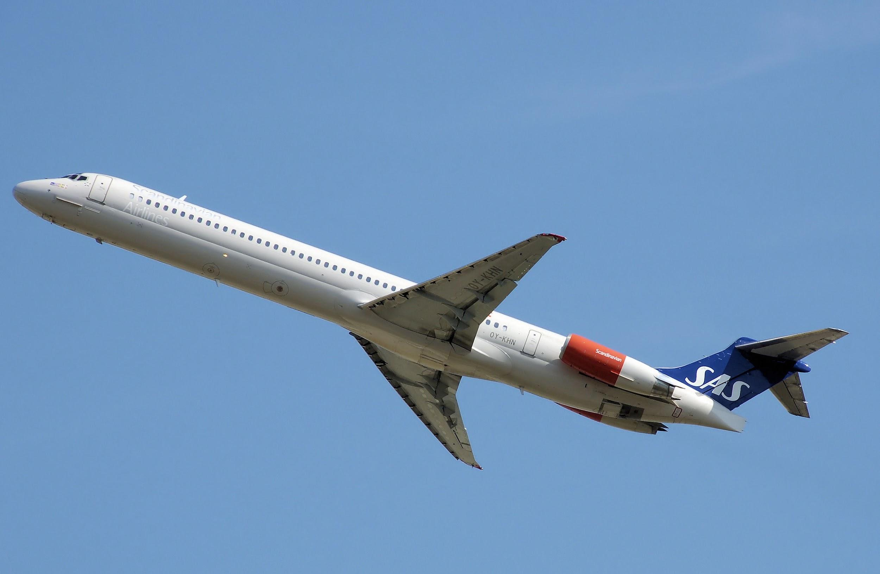
Flights – Southwest Airlines, Providence
Departure date Thursday, April 13, 2023*
ARRIVAL TIME AT MHS at 12:45 AM
Buses leave MHS at 1:45 am
Flight #766, departs 5:05am
Return date Monday, April 17, 2023
Flight #699, arrives 12:05am (early AM 4/18)
Buses arrive at MHS approx. 2:00 am
*Students will miss 2 days of school and will be held responsible for work missed. These will be considered excused absences.

Slide 5
Hotel Stay, Parks, Dining Cards
Disney’s All Star Music Resort
Night-Time Security from 10pm – 6am
Five Park Days
Group will visit a Disney Park every day
Including travel days & performance/workshop days
No downtime!
Park tickets, dining cards and room keys for
each group will be managed by Chaperones

Slide 6
Cris Antonio, RN – Trip Nurse
Medication drop off dates/times:
Friday, April 7, 6:30 – 8:00 pm, Band room
Monday, April 10, 6:30 – 8:00 pm, Band room
Medications are only given by me not by chaperones.
Inhalers and Epi Pens will be on your child’s person and carried in their carry-on bags NOT checked luggage.
On day of departure, give your teen their AM meds and notify me if you already dosed Dramamine. On our final day, your teen will receive their PM meds when they get home with you on Monday night (early Tues).
Sunscreen, Hydrate, Comfortable shoes!!!

Slide 7
Other Important Dates
Uniform Check
Wednesday, March 29, 5:00 – 8:00 pm, Band room
Wednesday, April 5, 5:00 – 8:00 pm, Band room
You MUST go to one of these times fully dressed in uniform:
Black dress pants, black socks, black dress shoes, white undershirt (boys)/white camisole or tank top (girls)
White Maynard Music polo shirt supplied by school
Luggage & Instrument Drop off
Wednesday, April 12, 3:00 – 6:00 pm
Remember to attach personal luggage tag to BOTH
WCV (color-coded) tags will be attached also during drop off

Slide 8
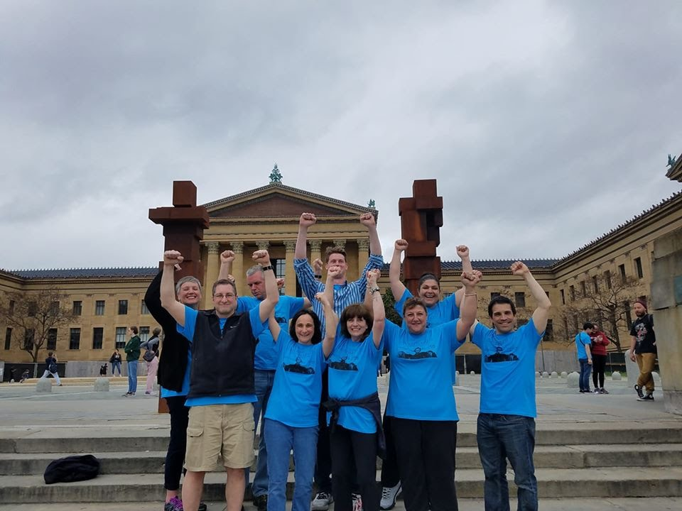
Denise Donovan, Head Chaperone
List of Chaperones*
Al Avery
Jake Begin
Stacey Briggs
Laura Burke
John and Beth Cafarella
Amanda Hemm
Sarah Johnson
Kerry Healy
*Individuals in this photo do not represent
your actual chaperones*

Slide 9
Role of Chaperones
Travel with their students at all times
Check in with students during park time
Ensure student are awake and at breakfast each day
Manage/distribute room keys, park tickets and dining cards
Room checks each night at curfew
Attend daily briefing each evening to review next day’s plans.

Slide 10
Behavioral Expectations
We are representing Maynard High School in Walt Disney World and during our travel to/from – let’s leave a good impression!
Always act as though you want to see the band take another trip!
The Behavioral Policy – signed many months ago - can be found in your packet.
Major violations of the policy will result in being sent home at your parent’s expense.

Slide 11
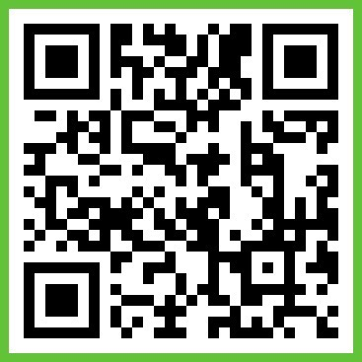
Band App
Our group will be using Band App to communicate within chaperone groups and among the adults on the trip. By now, all participants should have installed the Band App on their mobile device. This will allow the chaperones to set up their chat groups with their assigned students.
Install the Band App on the App Store (for iPhone) or the Google Play Store (for Android)
Joining a Band Group
After setting up your account, tap on the arrow button on the top left corner, then select “Find My Invitation”
Select “I got a QR code”. Make sure to select “allow” when the
app asks about using the camera so you can scan the code.
Scan the QR code to join the Disney Band App Group!
Select the settings icon in the bottom right corner; make sure
that the “push notifications” setting is turned on.

Slide 12
My Disney Experience App – Genie Service
Download the free My Disney Experience App to see park maps, food menus, wait times for attractions, etc.
You can also set up an account and link your park ticket to this App. Setting up an account is optional but highly recommended by our travel company. Detailed steps will be received tonight in your bag.
Should be done prior to trip
WCV suggests using a computer for this
Do NOT attempt to change our park reservations

Slide 13
What to Pack/Bring
Through generous donations, students will receive the following:
Sling bag to be used as carry-on for flights and day bag for parks
Orange t-shirt to be worn on first and last day during travel
Lanyard for holding park pass/dining card
Hand sanitizer
Polo shirts for performances will also be provided tonight – these are on loan and must be returned to the school
Attach personal luggage tags on BOTH the suitcase and instrument case
Flutes, clarinets, oboes and drumsticks/mallets should be packed in suitcase; all others will be considered a “checked” bag
Please read carefully the “Packing/Travel Instructions” pages in your packets

Slide 14
Important Reminders
PLEASE bring:
A portable phone charger – very important!
Spending money for meals not covered by dining cards (meant to cover 2 meals/day) and for souvenirs
Masks for traveling through the airport and on the flight
Snacks (appropriate for travel)
Students must bring a photo ID - school photo ID if under 18; government issued photo ID if 18+
All details have been posted on our Website
After Bill’s presentation, all students will be split into groups and meet with their chaperones to collect sling bag and materials

Slide 15
Travel Arrangements
Bill Lacey
Regional Performing Arts Director, WCV

