Slide 1
MHS BAND/CHORUS DISNEY 2023
Mandatory Music Family Meeting – September 8, 2022
Photos: Disney 2017

Slide 2
Purpose of tonight’s meeting
Provide information for students participating in Disney 2023.
Introduce our Nurse for the trip and our Head Chaperone.
Review required forms, payment dates, and optional travel insurance instructions.
Introduce our representative from World Class Vacations.
Information at tonight’s meeting continues to be subject to change as plans are finalized (ie. total # of students).

Slide 3
Meet the planning Committee
Cheryl Lucas, Danny Lucas: Trip Committee Co-Chairs
Kerry Healy: Secretary
Stacey Briggs: Treasurer
Denise Donovan: Head Chaperone
Brenda Waring RN: Lead Nurse
Alex Reyes and Katrina Cahill: Fundraising Co-Chairs
Wouter Leeuwis: Webmaster/Communications
Kevin Kozik: Band Director
Melissa Sommer: Chorus Director
Jason Weeks: Member at Large

Slide 4
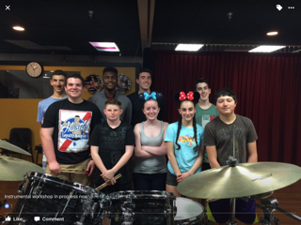
Musical Educational Experience
Performances
Both Band and Chorus will be performing on-stage!
Workshops
Instrumental (Band)
Vocal (Chorus)

Slide 5
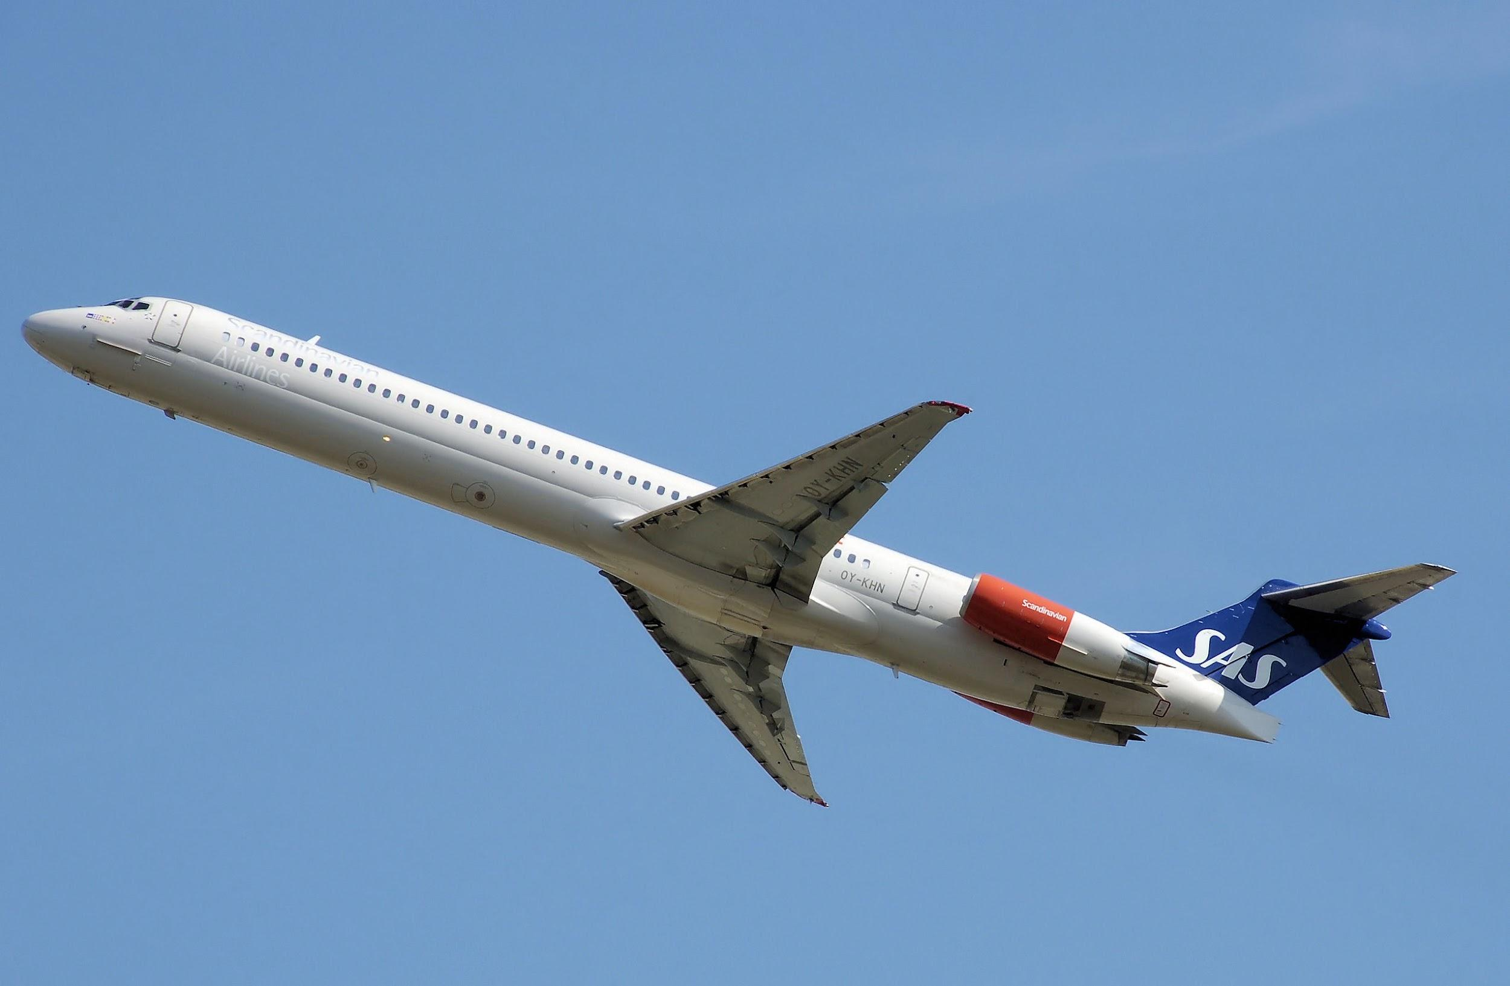
Travel dates
Departure date Thursday, April 13, 2023
Early departure
Return date Monday, April 17th (week of
April vacation)
Late day return
Students will miss 2 days of school and will be held responsible for work missed. These will be considered excused absences.

Slide 6
Student requirements
Academic eligibility - per MHS regulations, includes a minimum grade of 75 or higher in their music performing group
Discipline eligibility - no major disciplinary issues
Service points
Tracks participation in fundraising activities and music events (concerts, Casino Night, Jazz Café and other MMA events)
Students are expected to earn 5 service points between now and the time of our trip. Each service point equates to one hour of service
Those who are not able to earn 5 service points by the time of our trip will be expected to assist with loading/unloading equipment, etc. during the trip

Slide 7
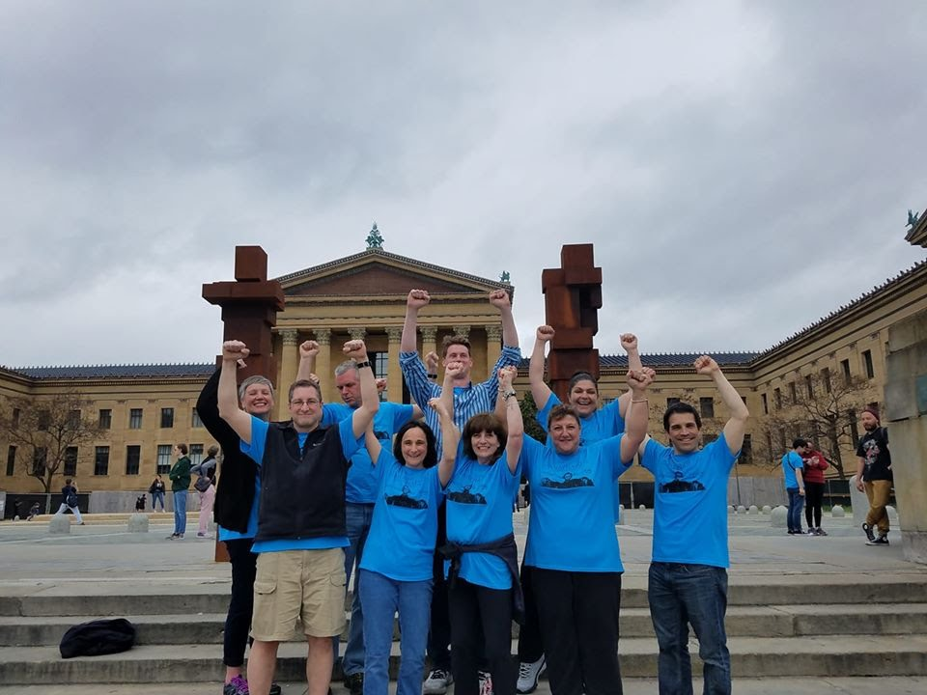
Chaperones, Nurse, Night-time Security
There will be one chaperone per 8/10 students plus one additional as a precaution (in case a student or chaperone needs to be isolated due to illness)
We will have a nurse on the trip to tend to any students in need of health care and to oversee daily meds
Night-time security guards will be in place every night to keep the students safe

Slide 8
Brenda Waring, RN – Trip Nurse
Mandatory health forms will be need to be completed by early January. Forms will be sent out in December.
The trip's COVID policy will closely follow the Maynard High School's trip policy.
Reach out at anytime via email: brenda.waring@yahoo.com
Subject: MHS Band/Chorus Disney Trip: student health information

Slide 9
Denise Donovan, Head Chaperone
List of Chaperones
Jake Begin
Stacey Briggs
Laura Burke
John and Beth Cafarella
Amanda Hemm
Sarah Johnson
Kerry or Jason Weeks

Slide 10
Cost
Approximately $2,000 per student, depending on fundraising
Optional travel insurance is available (must be purchased before final payment is made) – details and link were sent via email
Price will be paid over 3 installments plus a down payment
June 2022 - $200 (down payment)
September 19, 2022 - $600
November 14, 2022 - $600
December 19, 2022 - $600*
*Final payment will be adjusted based on final count and
fundraising collections.

Slide 11
Scholarships
Financial Assistance Scholarship applications are available to eligible families.
Please go to our website to access the form:
http://maynardmusic.org/disney-2023
Forms must be completed entirely to be considered
HS Guidance office will confirm eligibility
All applications will be kept confidential
Deadline for submission is September 12, 2022

Slide 12
Fundraising
Complete:
Corporate sponsors
Linens/towels fundraiser
Restaurant % donations at Evviva, Maynard
Farmers’ Market Jazz band
Upcoming:
Restaurant % donations at 110 Grill, Maynard – 9/14/22
Lyndell’s Thanksgiving pies
Script gift card program
Family movie night - 12/1/22
Independent student jobs (snow shoveling, etc.)
Music playing gigs – Independent or as a group
Music students will be expected to fully participate in fundraising for both group and individual events/programs. The more they participate, the lower their cost!!

Slide 13
What we need
Chaperones – We have 8; looking for at least 1 more
CONTACT: Denise Donovan
Subcommittee members to assist as needed throughout our planning and with final preparation.
Volunteers to help with fundraising events
CONTACTS: Alex Waldron, Katrina Cahill
Submission of forms and payment installments on time.
Carefully read through your information packet from tonight and all future communications you receive - many details are finalized closer to the trip.

Slide 14
Next steps
Email questions, concerns to Cheryl Lucas at cheryldanlucas@comcast.net
Keep in mind - tonight’s info is as close as we can offer it at this time, without knowing the exact number of students participating.
Please be sure to confirm we have your correct email on the sign-in sheet so we can make sure you get all updates. Band and chorus students will also receive notices about the Disney trip from Mr. Kozik and Ms. Sommer.
Additional parent/student meetings will be planned as needed. Also, the committee will be reaching out for any missing forms or payments.

Slide 15
Travel Arrangements
Bill Lacey
Regional Performing Arts Director, WCV

